Slide 1
FM
1375003
KyungSil Kim
ks_tina@naver.com
Department of Electronics Engineering
Ewha Womans University

Slide 2
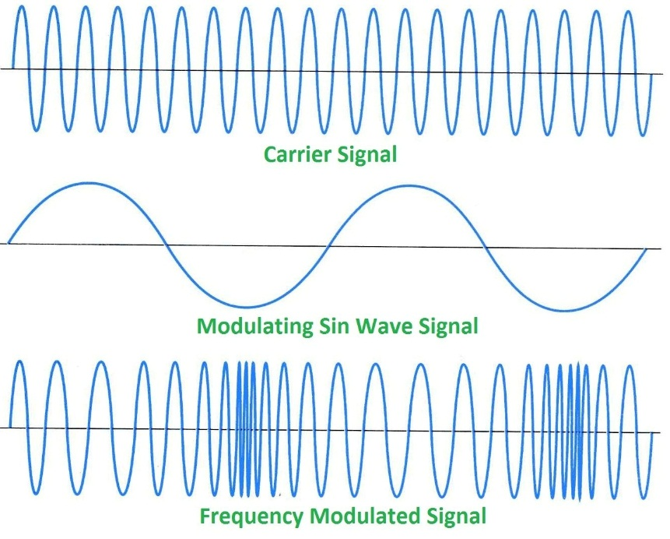
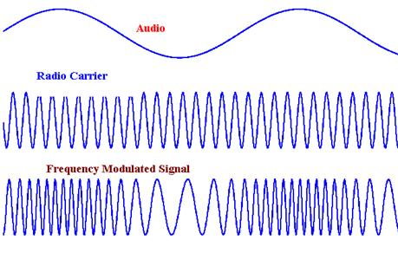
Frequency Modulation (FM)
Vary the frequency of the signal to modulate
  Frequency of the signal varies as the voltage of the modulating signal changes.
  The amount by which the signal frequency varies is very important.
  (= Deviation)

Slide 3
Frequency Modulation (FM)
Advantages
  Resilient to noise & signal strength variations.
  Does not require linear amplifiers in the transmitter.
  Enables greater efficiency than many other modes.
Disadvantages
  Requires more complicated demodulator.
  Some other modes have higher data spectral efficiency.
  Sidebands extend to infinity either side.

Slide 4
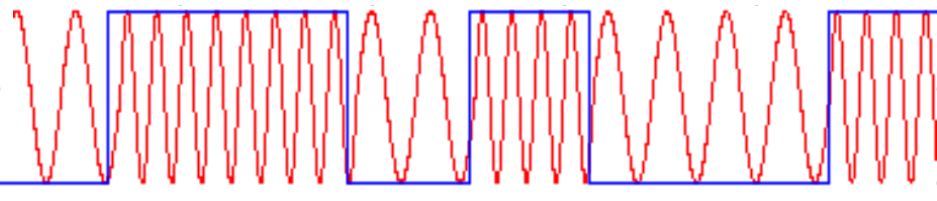

What would be the resulting modulated signal?
Original signal is square wave
The transmitter sends different frequencies for a 1 than for 0.
I assumed that signal 1 is modulated to high frequency while 0 is modulated to low frequency.
  Original signal and modulated signal
  Modulated signal

Slide 5
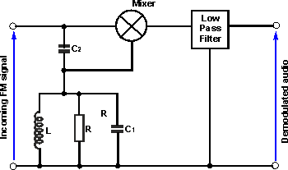
How the Quadrature detector works for FM signal recovery

Slide 6
How the Quadrature detector works for FM signal recovery
Quadrature detector splits the signal up into 2 signals
  First signal remains unchanged, applied to the input of a phase detector
  Second signal is passed through a capacitor → capacitor will create a 90° phase shift → phase shifted signal is applied to a frequency dependent phase shifter(a LC tank circuit)
If the LC tank circuit’s center frequency equals the signal’s frequency
  Imposes a further phase shift of 0° on the signal
  Overall phase difference will remain 90°
If the center frequency is different from the signal’s frequency
  LC tank will further shift the phase of the signal from the capacitor → the signal’s total phase shift will be the sum of the 90° shift.
  If the frequency increases the phase shift of the LC circuit decreases.
  Overall phase difference decreases as the frequency increases.

Slide 7
How the Quadrature detector works for FM signal recovery
If the original signal and the phase shifted signal are applied to the input of a phase detector, the modulation signal can be recovered easily.
Advantages
  Offers good level of performance and includes linearity
  Can be incorporated into an integrated circuit
Disadvantages
  Requires the use of coil
  Some designs may require setting during manufacture

